Slide 1
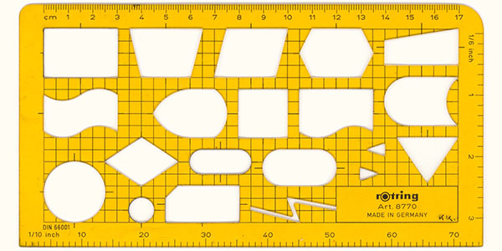
Introduction to Flowcharts
L4

Slide 2
Objectives
To learn and appreciate the following concepts
Flow charts
Draw flowcharts for simple problems

Slide 3
Session outcome
At the end of session student will be able to
Draw flowcharts for simple algorithms

Slide 4
Representation of computation
In Computer Science, Flow chart is used to represent algorithm which basically provides a solution to any computational problem.
Flowchart: A graphical/pictorial representation of computation

Slide 5
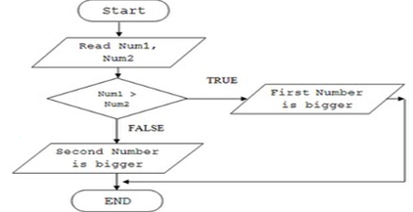
Algorithm and Flow chart
Step 1: start
Step 2: input num1,num2
Step 3: if num1>num2 then
print num1 is bigger
otherwise
print num2 is bigger
Step 4: end
Algorithm
Flowchart
Notes:
Additional notes - Difference between flow chart and pseudo code
Pseudo code is a sentence-like representation of a piece of code. A flowchart is a symbolic representation of code, using box shapes and arrows

Slide 6
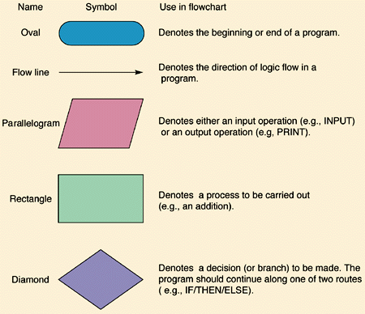
Basic Flowchart Symbols

Slide 7
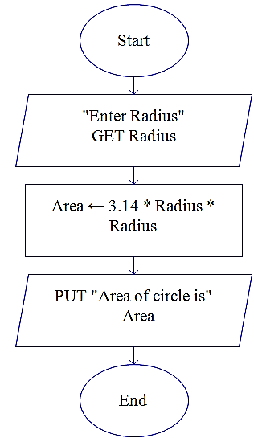
Algorithm and Flowchart for area of the circle
Name of the algorithm : Compute the area of a circle
Step1: Input radius
Step 2: [Compute the area]
Area ← 3.1416 * radius*radius
Step 3: [Print the Area]
Print ‘Area of a circle =‘, Area
Step 4: [End of algorithm]
Stop
Flowchart:
AreaC

Slide 8
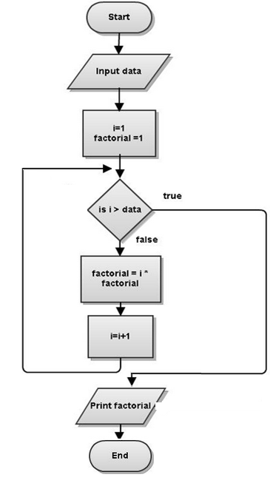
Flowchart to find factorial of given no
Name of the algorithm: Compute the factorial of a number
Step1: start
Step 2: Input data
Step 3: factorial ←1
Step 4: For i=1 to N in step of 1 do
begin
factorial←factorial*i
end
Step 5: Print ‘fact of N=‘, factorial
Step 6: [End of algorithm]
Stop
Notes:
Factorial computing
Factorials are very simple things. They're just products, indicated by an exclamation mark. For instance, "four factorial" is written as "4!" and means 1×2×3×4 = 24. In general, n! ("enn factorial") means the product of all the whole numbers from 1 to n; that is, n! = 1×2×3×...×n.

Slide 9
Key features of flow charts
Diagrammatic / visual / graphical representation of computation of an algorithm/pseudo code
Easier to understand and analyze the problem and it’s solution before programming
Machine independent
Well suited for any type of logic

Slide 10
Summary
Raptor tool
Notes (Raptor)
Control Flow
Video clip
Software
Do it yourself
Review questions
Introduction to Flowcharts
Draw flowcharts for simple programs

